Slide 1

How does the demographic characteristics and background of someone affect wage or employment chances?
By Song Han

Slide 2
All datasets used
avgMonthWagebySex(https://beta.data.gov.sg/collections/642/view)
UnemploymentbyEducation(https://stats.mom.gov.sg/Pages/UnemploymentTimeSeries.aspx)
UnemploymentbyAge (https://stats.mom.gov.sg/Pages/UnemploymentTimeSeries.aspx)
UnemploymentYearly(https://beta.data.gov.sg/datasets/d_e3598914c86699a9a36e68190f78c59a/view)
wageByIndustryByGender(https://beta.data.gov.sg/collections/671/view)
TotalForeignWorkforce (https://beta.data.gov.sg/datasets/d_ce0511e418694cd265a3a6fc8c266782/view)
ResidentUnemploymentRateAnnual(https://beta.data.gov.sg/datasets/d_8a806a11f7b8807441f967a824fa578e/view)
crimeRate (https://splms.polite.edu.sg/d2l/le/enhancedSequenceViewer/345433?url=https%3A%2F%2Fb988e89b-eb2c-401a-999a-94b943da0008.sequences.api.brightspace.com%2F345433%2Factivity%2F6797415%3FfilterOnDatesAndDepth%3D1)
ResidentLabourForcebyLabourForceStatusAgeAndSex (https://beta.data.gov.sg/collections/1921/view)

Slide 3
avgMonthWagebySex
*Monthly Wage by Sex*
This dataset has 75 rows and 3 columns
Column Data
- Name: year (Data Type: int64)
- Name: sex (Data Type: object)
- Name: average_monthly_earnings (Data Type: int64)
There is 0 missing values

Slide 4
UnemploymentbyEducation
*Unemployment Rate by HQA*
This dataset has 155 rows and 3 columns
Column Data
- Name: year (Data Type: int64)
- Name: highest_qualification_attained (Data Type: object)
- Name: unemployment_rate (Data Type: float64)
There is 0 missing values

Slide 5
UnemploymentbyAge
*Unemployment Rate by Age*
This dataset has 279 rows and 3 columns
Column Data
- Name: year (Data Type: int64)
- Name: age (Data Type: object)
- Name: unemployment_rate (Data Type: float64)
There is 0 missing values

Slide 6
UnemploymentYearly
*Unemployment Rate Annually*
This dataset has 31 rows and 3 columns
Column Data
- Name: year (Data Type: int64)
- Name: residential_status (Data Type: object)
- Name: unemployment_rate (Data Type: float64)
There is 0 missing values

Slide 7
wageByIndustryByGender
*Wage by Industry & Gender*
This dataset has 528 rows and 6 columns
Column Data
- Name: year (Data Type: int64)
- Name: occ_desc (Data Type: object)
- Name: sex1 (Data Type: object)
- Name: sex2 (Data Type: object)
- Name: mthly_gross_wage_50_pctile (Data Type: int64)
- Name: mthly_basic_wage_50_pctile (Data Type: int64)
There is 0 missing values

Slide 8
TotalForeignWorkforce
*Total Foreign Workforce*
This dataset has 6 rows and 2 columns
Column Data
- Name: month (Data Type: object)
- Name: count (Data Type: object)
There is 0 missing values

Slide 9
ResidentUnemploymentRateAnnual
*Resident Unemployment Rate Annually*
This dataset has 31 rows and 3 columns
Column Data
- Name: year (Data Type: int64)
- Name: residential_status (Data Type: object)
- Name: unemployment_rate (Data Type: float64)
There is 0 missing values

Slide 10
crimeRate
*Crime Rate*
This dataset has 90 rows and 4 columns
Column Data
- Name: year (Data Type: int64)
- Name: level_1 (Data Type: object)
- Name: level_2 (Data Type: object)
- Name: value (Data Type: int64)
There is 0 missing values

Slide 11
ResidentLabourForcebyLabourForceStatusAgeAndSex
*Resident Labour Force*
This dataset has 696 rows and 7 columns
Column Data
- Name: year (Data Type: int64)
- Name: sex (Data Type: object)
- Name: age (Data Type: object)
- Name: labour_force (Data Type: int64)
- Name: employed (Data Type: int64)
- Name: unemployed (Data Type: object)
- Name: outside_labour_force (Data Type: int64)
There is 0 missing values

Slide 12
Dropping Unnecessary Columns & Rows
# UnemploymentbyEducation
UnemploymentbyEducation = UnemploymentbyEducation.drop('year', axis = 1)
# UnemploymentbyAge
UnemploymentbyAge = UnemploymentbyAge.drop('year', axis = 1)
UnemploymentbyAge.drop(UnemploymentbyAge[UnemploymentbyAge["age"] == 'below 30'].index, inplace=True)
UnemploymentbyAge.drop(UnemploymentbyAge[UnemploymentbyAge["age"] == '25 & over'].index, inplace=True)
UnemploymentbyAge.drop(UnemploymentbyAge[UnemploymentbyAge["age"] == '50 & over'].index, inplace=True)
# wageByIndustryByGender
wageByIndustryByGender = wageByIndustryByGender.drop(['mthly_gross_wage_50_pctile','sex1','year'], axis=1)
# ResidentLabourForcebyLabourForceStatusAgeAndSex
ResidentLabourForcebyLabourForceStatusAgeAndSex.drop('outside_labour_force',axis=1, inplace=True)

Slide 13
Subsetting Columns & Rows
# avgMonthWagebySex
avgMonthWagebySex = avgMonthWagebySex[(avgMonthWagebySex.sex == 'female') | (avgMonthWagebySex.sex == 'male’)]
# UnemploymentYearly
UnemploymentYearly_copy = UnemploymentYearly_copy[UnemploymentYearly_copy.year > 2009]
UnemploymentYearly_copy = UnemploymentYearly_copy[(UnemploymentYearly_copy.year > 2004) & (UnemploymentYearly_copy.year <2020)]
# ResidentUnemploymentRateAnnual
ResidentUnemploymentRateAnnual =ResidentUnemploymentRateAnnual[ResidentUnemploymentRateAnnual.year > 2016]
# ResidentLabourForcebyLabourForceStatusAgeAndSex
ResidentLabourForcebyLabourForceStatusAgeAndSex = ResidentLabourForcebyLabourForceStatusAgeAndSex[ResidentLabourForcebyLabourForceStatusAgeAndSex.year == 2022]
ResidentLabourForceMale = ResidentLabourForcebyLabourForceStatusAgeAndSex[ResidentLabourForcebyLabourForceStatusAgeAndSex.sex == 'male']
ResidentLabourForceFemale = ResidentLabourForcebyLabourForceStatusAgeAndSex[ResidentLabourForcebyLabourForceStatusAgeAndSex.sex == 'female’]

Slide 14
Groupby
# UnemploymentbyEducation
UnemploymentbyEducation = UnemploymentbyEducation.groupby(by='highest_qualification_attained')[['unemployment_rate']].mean()
# UnemploymentbyAge
UnemploymentbyAge = UnemploymentbyAge.groupby(by='age')[['unemployment_rate']].mean()
# crimeRate
crimeRate = crimeRate.groupby(by='year')[['value']].sum()

Slide 15
avgMonthWagebySex
# pivoting the dataset
avgMonthWagebySex = avgMonthWagebySex.pivot(index='year', columns='sex' , values='average_monthly_earnings')

Slide 16
UnemploymentYearly
# made a copy of the dataset to not affect the original dataset
UnemploymentYearly_copy = UnemploymentYearly.copy()

Slide 17
wageByIndustryByGender
# keep all rows that are duplicated
wageByIndustryByGender = wageByIndustryByGender[wageByIndustryByGender['occ_desc'].duplicated(keep=False)]
# pivot the table
wageByIndustryByGender = wageByIndustryByGender.pivot_table(index='occ_desc', columns='sex2' , values='mthly_basic_wage_50_pctile', aggfunc='first’)
# made a new column for the difference of male and female column
wageByIndustryByGender['d'] = abs(wageByIndustryByGender['males'] - wageByIndustryByGender['females’])

Slide 18
TotalForeignWorkforce
# remove the ‘,’ in the values
for i in TotalForeignWorkforce.index:
TotalForeignWorkforce.loc[i]['count'] = TotalForeignWorkforce.loc[i]['count'].replace(",", "")
# concatenate two datasets together
merged = pd.concat([TotalForeignWorkforce, ResidentUnemploymentRateAnnual], axis=1)
# change values to numeric
merged['count'] = pd.to_numeric(merged['count'])

Slide 19
ResidentUnemploymentRateAnnual
# concatenate two datasets together
merged = pd.concat([TotalForeignWorkforce, ResidentUnemploymentRateAnnual], axis=1)

Slide 20

Insights

Slide 21
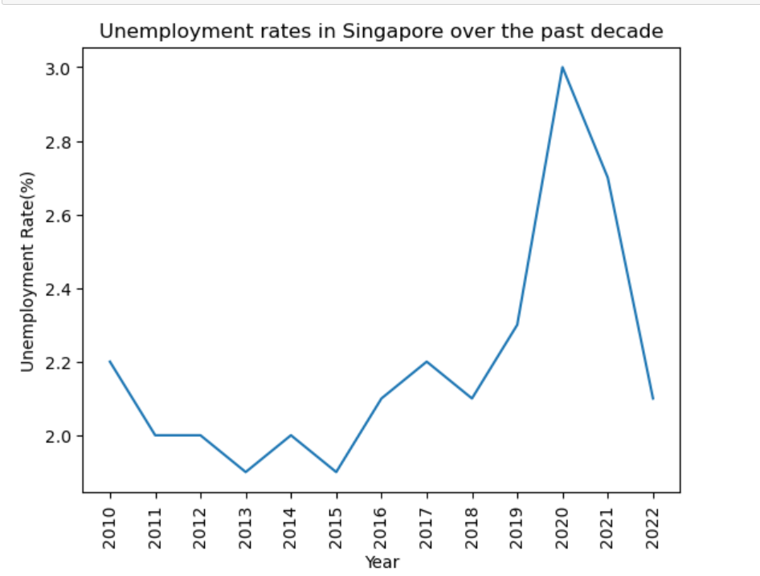
Historical Trend Of The Unemployment rate over the past decade
From the Line Graph, we can see that the unemployment rate in Singapore fluctuates alot . however in 2020 , the unemployment rate increased significantly to 3.0%.This could be highly likely due to Covid-19 affecting Job Opportunities.

Slide 22
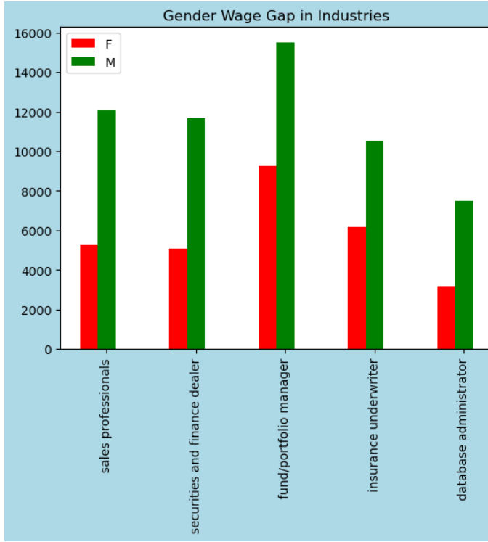
Does Gender Affect Wage?
Top 5 Industries with the largest gender wage gap
From the Bar Graph, We can see that the industries with the largest Gender Wage Gap is business related industries.With Male's wages doubling or close to doubling Female wages

Slide 23
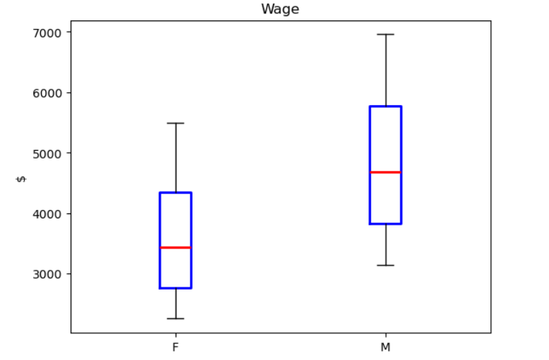
Wage and Unemployment Rate Difference by Gender
In general, Males do earn more than Females.Males with a Median Wage of around 4500SGD/month and Females with a Median Wage of around 3500SGD/ month

Slide 24
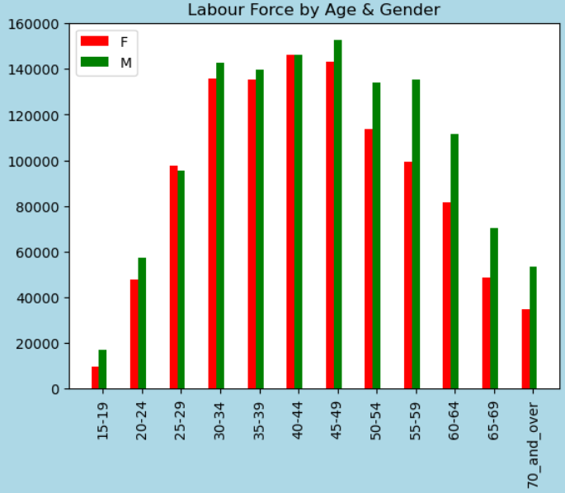
Labour Force by Age & Gender
What we can interpret from this graph is that Females generally retire earlier than Males, at around 50-54 years old. This could be due to females having to take up care giving responsiblities towards their child

Slide 25
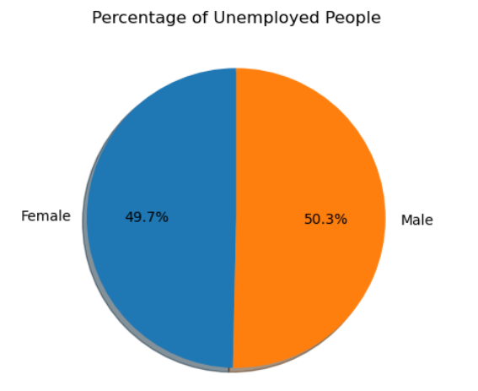
Proportion of Unemployed people
In General, Unemployed people are equally distributed to male and female

Slide 26
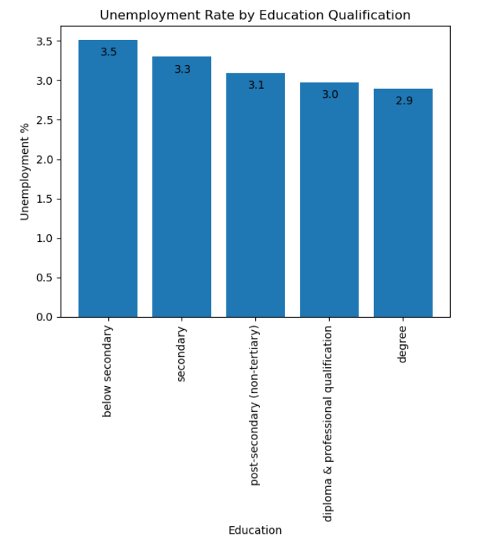
Does someone’s Education Qualification affect their Employment Chances
We can see that as someone's Highest Qualification Attained increases, their chance of unemployment decreaes

Slide 27
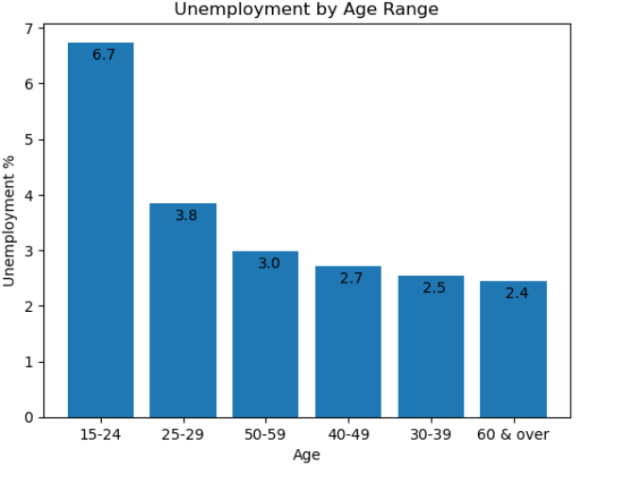
Does someone's Age affect their employment chances?
We can see from the graph that 15-24 year olds have a very high unemployment rate, this could be due to companies discriminating youths as they have less experience

Slide 28
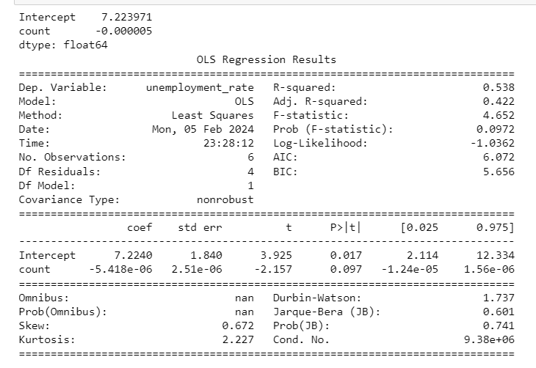
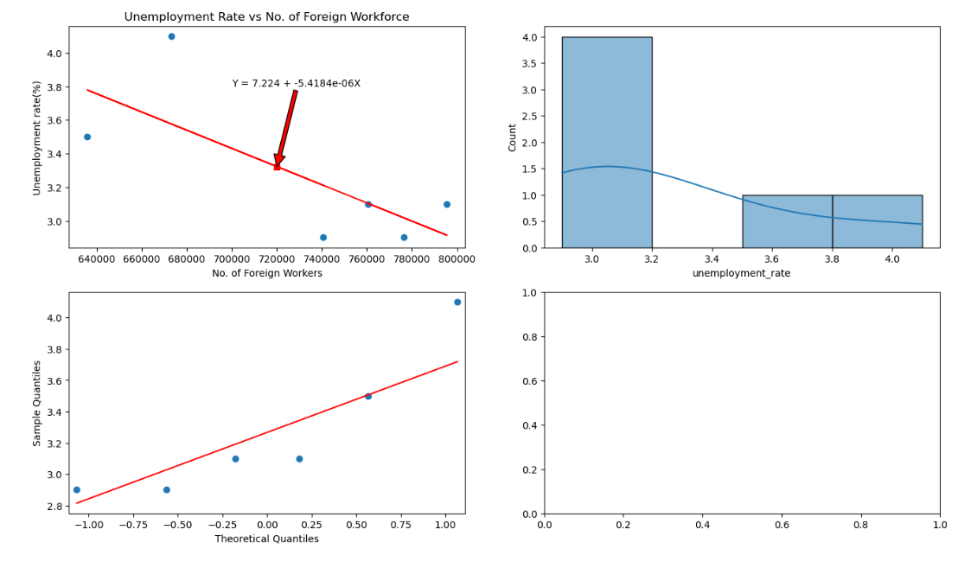
Does Foreign Workforce Affect Residents' Employment Chances?
With a R-squared value of 0.538, there is a negative moderate relationship between the number of foreign workforce and unemployed residents.This is unexpected as you would think that as the foreign workforce increaes, there will be a lower job vacancy for residents, by extension , increasing the unemployment rate.However this is not the case.

Slide 29
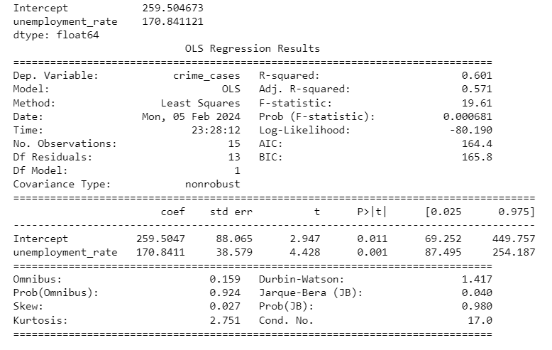
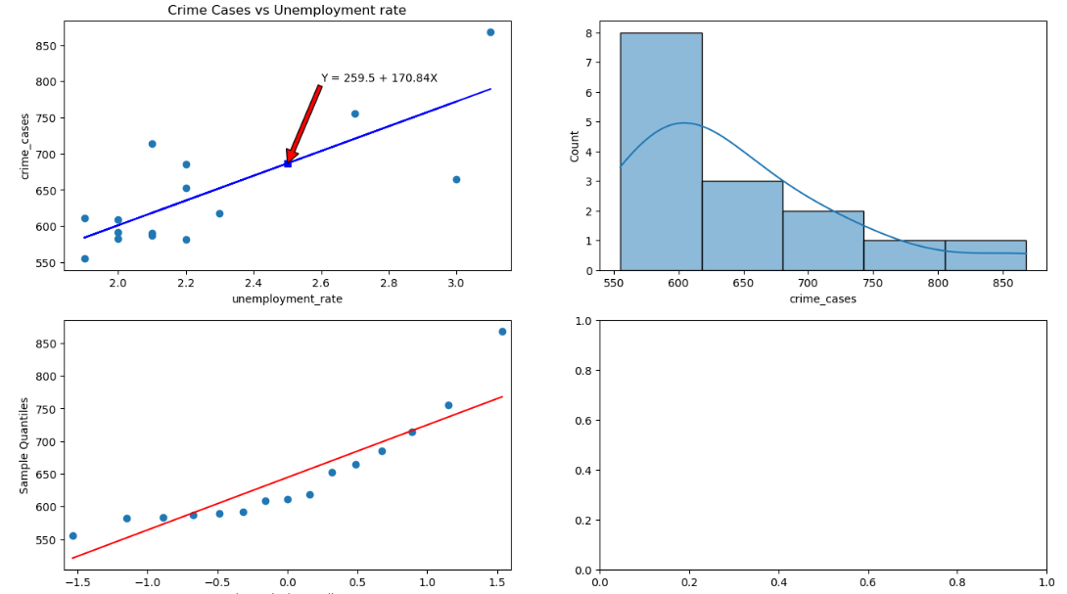
How does Unemployment Affect Singapore? Increased Crime Rates
With a R-squared value of 0.601, there is a positive moderate relationship between the amount of crime cases and unemployment rate.This tells us that Unemployment could cause an increase in crime cases.

Slide 30

Thank you for your kind attention!

